Slide 1

A
Presentation on
Design and Fabrication of Mecanum Wheels for Forklift Applications
Under the Guidance of:
Mr. Rajkumar Baghel
Symbiosis Skills and Professional University
Village – Kiwale, Adjoining Pune Mumbai Expressway, Pune – 412101,
Maharashtra, India.

Slide 2
Team Members
Karan S. Tomar (1900501018)
Kishan Gohel (1900501022)
Krutarth Gohel (1900501023)
Jay Hiran (1900501029)
Navodit Sankhyan (1800501019)
SCHOOL OF AUTOMOBILE ENGINEERING

Slide 3
Contents
Mecanum Wheel Introduction
Objectives
Methodology
Literature Survey
Components
Construction
SCHOOL OF AUTOMOBILE ENGINEERING

Slide 4
Contents
CAD Models
Plan Of Execution
Applications
Advantages
Future Scope
Conclusion
SCHOOL OF AUTOMOBILE ENGINEERING

Slide 5
A wheel system that can provide omnidirectional movement for the forklifts.
A wheel system allowing forklift to move in any direction without changing its orientation.
This could be particularly useful in tight spaces where maneuverability is limited, such as in warehouses or factories.
Increasing efficiency of material movement by reducing travelling distance.
Problem Statement
SCHOOL OF AUTOMOBILE ENGINEERING

Slide 6
Mecanum Wheel Introduction
It is an omnidirectional wheel for vehicle to maneuver in any direction.
It is a form of tireless wheel.
It has series of rubberized external rollers.
The rollers are obliquely attached to the rim.
The rollers have an axis of rotation at 45° to the wheel plane.
The rollers have an axis of rotation at 45° to the axle line.
SCHOOL OF AUTOMOBILE ENGINEERING

Slide 7
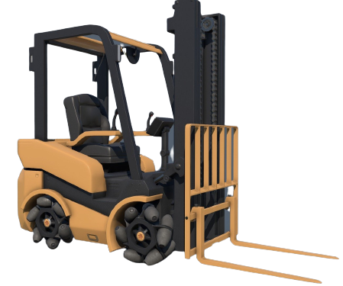
Mecanum Wheel in Forklift
SCHOOL OF AUTOMOBILE ENGINEERING

Slide 8
These are similar to tracked chain vehicle system.
These provides better maneuverability.
It has series of rubberized external rollers.
Rollers are obliquely attached to rim.
Rollers have axis of rotation at 45° to wheel plane.
Rollers have axis of rotation at 45° to axle line.
Literature Survey
SCHOOL OF AUTOMOBILE ENGINEERING

Slide 9
Each wheel is non-steering drive wheel.
Each wheel is independent and has its own powertrain.
Wheel spinning generates propelling force.
This force is perpendicular to roller axle.
It is then vectored into a longitudinal component.
And also transverse component.
Literature Survey
SCHOOL OF AUTOMOBILE ENGINEERING

Slide 10
Project Flowchart
Literature Survey
Define Objective
Material Selection
Fabrication
Conclusion
Design Of Physical Model
Understand Problem Statement
SCHOOL OF AUTOMOBILE ENGINEERING

Slide 11
Plan Of Execution
SCHOOL OF AUTOMOBILE ENGINEERING

Slide 12
To be able to design Mecanum wheel.
To able use the wheel to help the vehicle maneuver in different directions.
To able use the wheel to help the vehicle maneuver in different directions.
To develop a low cost prototype model of Mecanum Wheel.
Objectives
SCHOOL OF AUTOMOBILE ENGINEERING

Slide 13
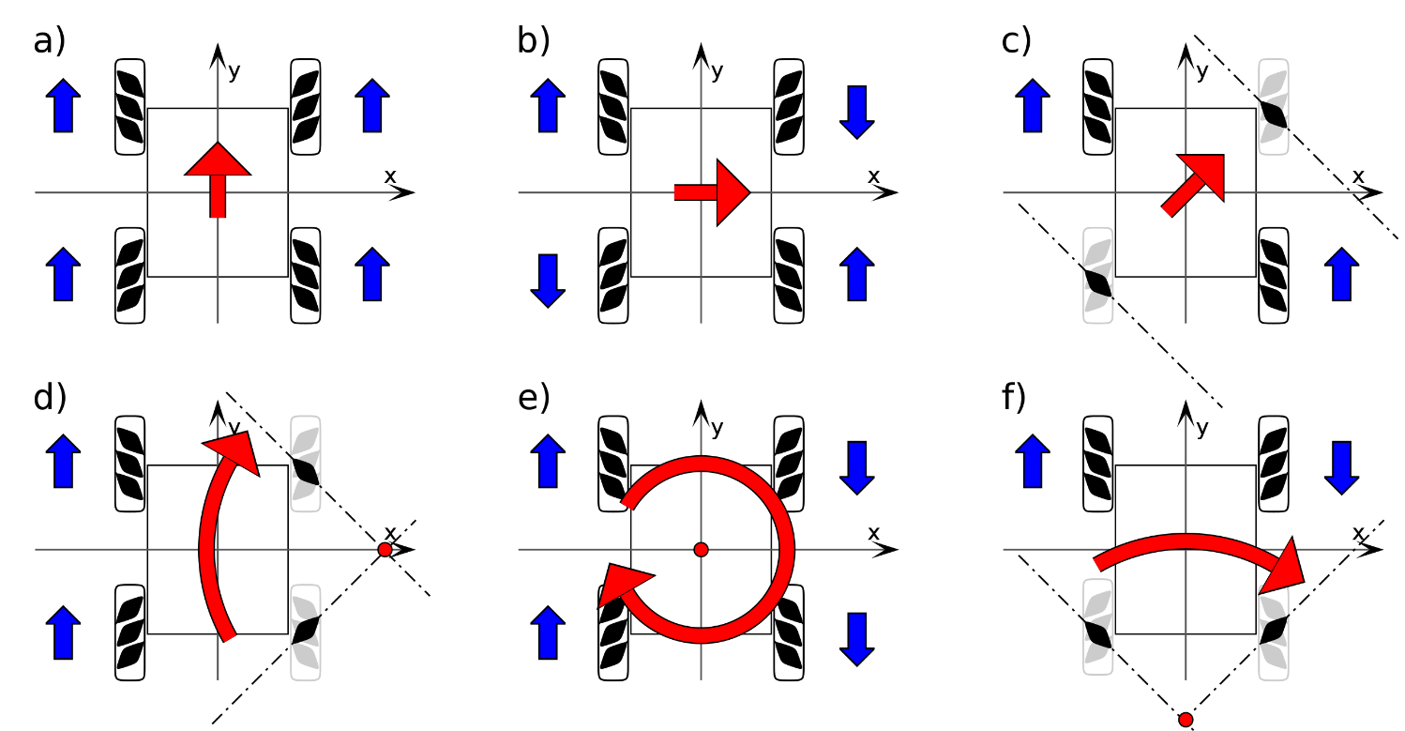
Methodology
SCHOOL OF AUTOMOBILE ENGINEERING

Slide 14
Direction of movement | Wheel actuation
Forward | All wheels forward same speed
Reverse | All wheels backward same speed
Right shift | Wheel 1-4 forward Wheel 2-3 backward
Left shift | Wheel 2-3 forward Wheel 1-4 backward
Clockwise turn | Wheel 1-3 forward Wheel 2-4 backward
Counter clockwise turn | Wheel 2-4 forward Wheel 1-3 backward
Methodology
SCHOOL OF AUTOMOBILE ENGINEERING

Slide 15

Working Animation
SCHOOL OF AUTOMOBILE ENGINEERING

Slide 16
Frame
Rubberized Roller
Arduino Uno
Motor
Power Supply (Power Bank)
Chassis
Circuit (Power Distribution)
Components
SCHOOL OF AUTOMOBILE ENGINEERING

Slide 17
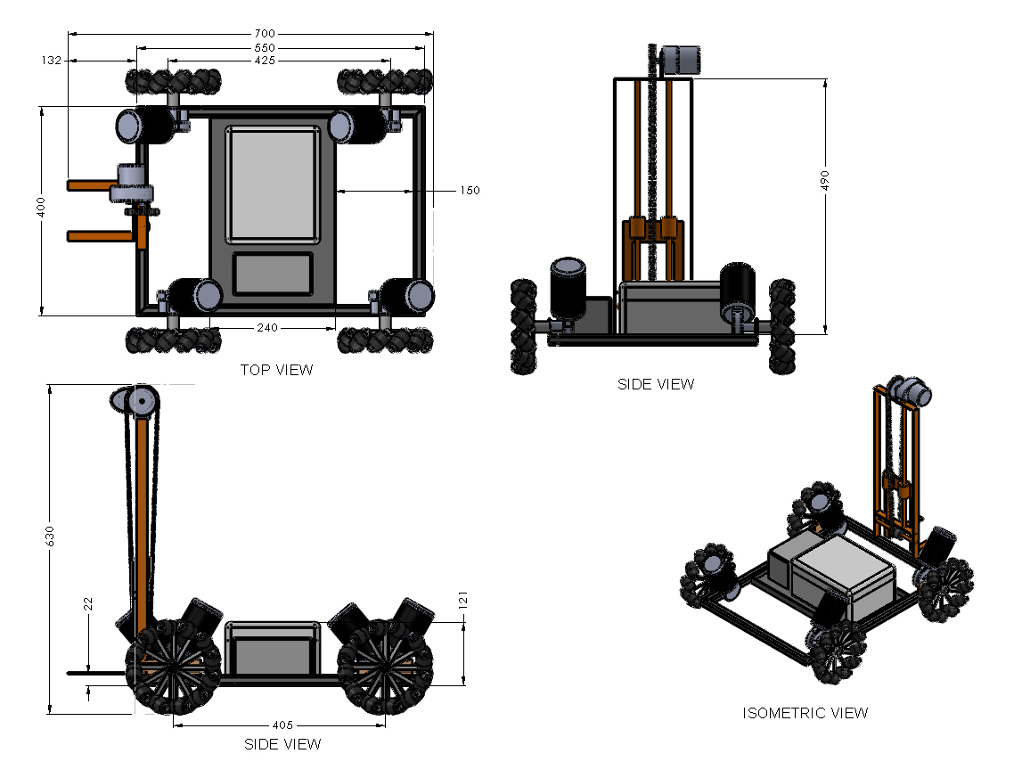
CAD Models and Drawings
SCHOOL OF AUTOMOBILE ENGINEERING

Slide 18
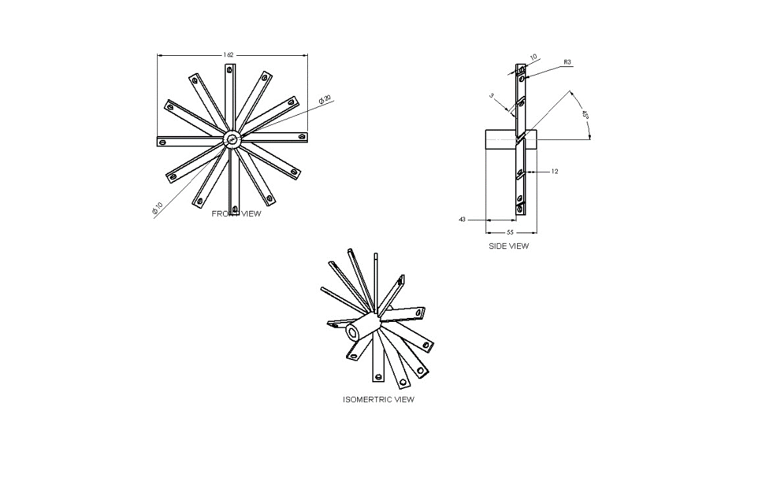
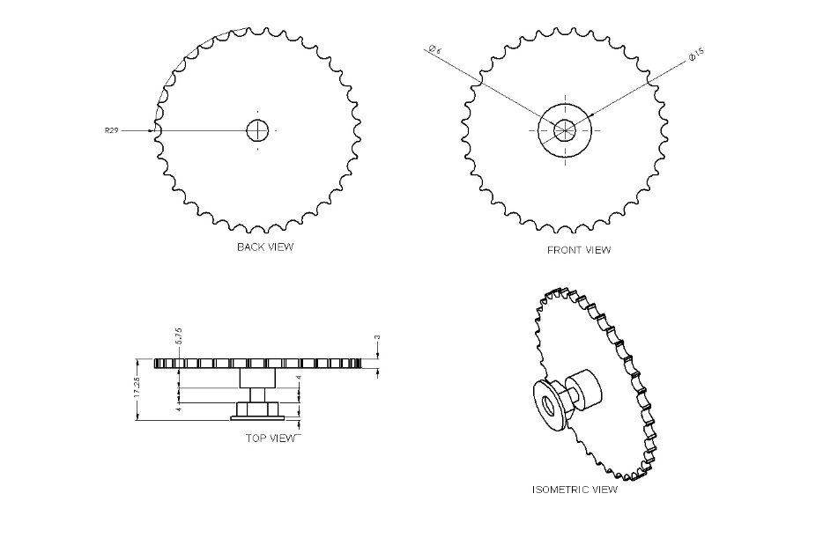
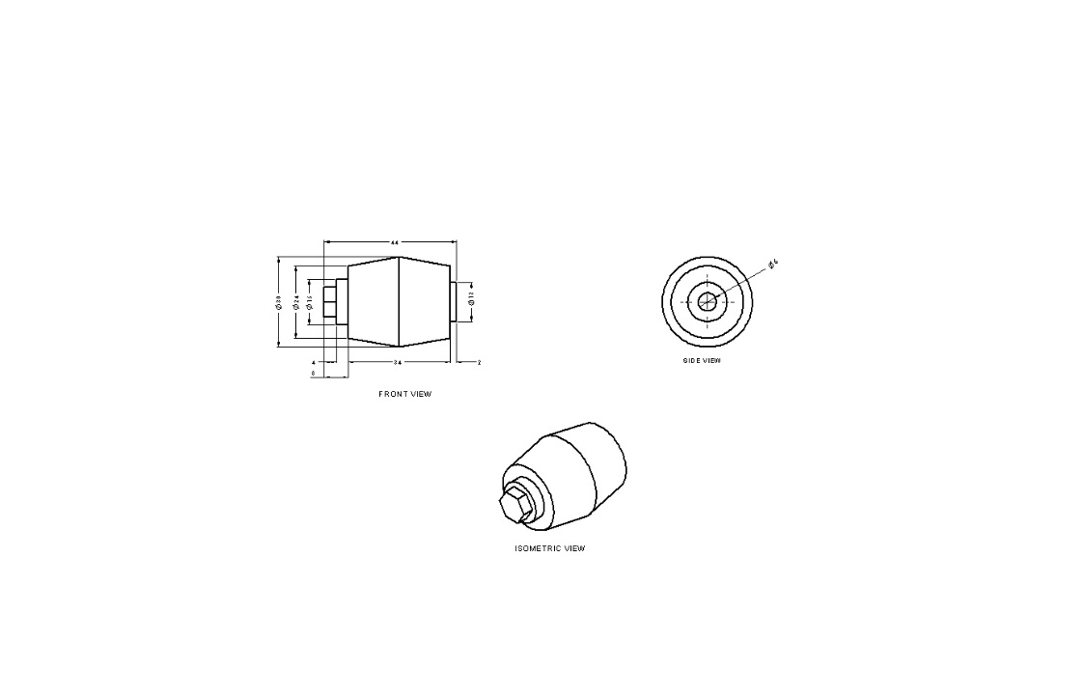
CAD Models and Drawings
SCHOOL OF AUTOMOBILE ENGINEERING

Slide 19
Can help the vehicle move in any direction.
There is no additional friction while turning.
It allows for in-place rotation with minimal ground friction.
It also allows for in-place rotation with low torque.
It is much simpler and more reliable than crab drive system.
Advantages
SCHOOL OF AUTOMOBILE ENGINEERING

Slide 20
Mecanum Wheels are marginally heavier than their conventional counterparts.
They cost higher.
The smaller contact area disables its use in passenger cars.
Used for low speed drive.
Vertical and horizontal vibrations.
Future Scope
SCHOOL OF AUTOMOBILE ENGINEERING

Slide 21
Wheel chairs
Automated Guided Vehicles (AGV)
Military vehicles
Forklift trucks
Flexible Parking
Shopping cart
Applications
SCHOOL OF AUTOMOBILE ENGINEERING

Slide 22
The Mecanum wheel is a design for a wheel which can move a vehicle in any direction and can perform in-place rotation.
Tracked vehicles and skid steer vehicles utilize similar methods for turning. However, these vehicles typically drag across the ground while turning and may do considerable damage to a soft or fragile surface.
Compared to skid steer, Mecanum wheels have no additional friction when turning which is an advantage.
Conclusion
SCHOOL OF AUTOMOBILE ENGINEERING

Slide 23
By comparison, the design of the Mecanum wheel allows for in-place rotation with minimal ground friction and low torque.
Mecanum wheels will be simpler and perhaps more reliable than a swerve/crab drive system.
It cannot be used in regular car because it is usually used for low-speed drive.
Conclusion
SCHOOL OF AUTOMOBILE ENGINEERING

Slide 24
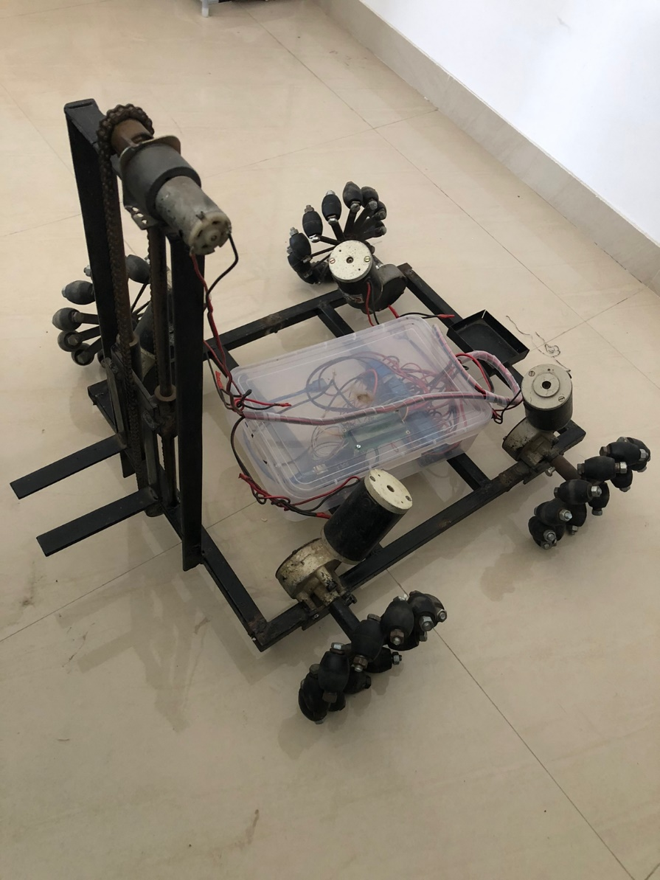
Prototype
SCHOOL OF AUTOMOBILE ENGINEERING

Slide 25
Thank
You
SCHOOL OF AUTOMOBILE ENGINEERING

